Slide 1

Artificial Intelligence Powered Face Analysis System
Group ID :26
DEPARTMENT OF INFORMATION TECHNOLOGY PES’S MODERN COLLEGE OF ENGINEERING SHIVAJINAGAR,PUNE. 2022-23
Guide : C.A Ghuge
Shubham Virkar B190318648
Rupa Kunwar B190318593
Tejaswini Kenjarla B190318581
Praphull Mehtre B190318627

Slide 2
Table of Contents
Introduction
Project Goal
Problem Statement
Proposed System
Architecture of System
Applications
Future Work
Results
Conclusion

Slide 3
Problem Statement
To build a expression, gender and age detector that can approximately guess the gender, age and expression (Neutral, Surprised, Disgusted, Fearful, Sad, Angry, Happy) of the person in a picture using Deep Learning

Slide 4
Introduction
The aim is to predict the age, gender and expression of individuals using image data sets.
A growing number of applications, especially after the increase in social networks and social media, are being concerned with automatic age classification.
Age, gender and expression are the three most fundamental facial qualities in social interaction. In smart applications, such as access control, human computer interaction, enforcement, marketing intelligence and visual supervision, etc, it is important to make age evaluations using one facial image.
Machine learning: supervised learning, image recognition, and deep learning: a ground-breaking neural network and profound learning are the most common technologies.

Slide 5
Proposed System
The aim of proposed system is to build complete analysis of face i.e. age, gender, expression on face.
Our main aim to build ensemble model which will on maximum available database giving best results.
There are 2 process in proposed work:
Age and Gender recognition:The main objective of the proposed work to develop a model for the prediction of human age and gender.
Expression Recognition: The main objective of the proposed work to develop a model for the prediction of human facial expression.
We will be building website were we will use our trained model to recognize age, gender, expression of human in given image.

Slide 6
Architecture of System
Our models are divided into three steps:
A. Face Expression Recognition:
Face Detection (Tiny Face Detection Model)
Face Landmark Detection (68 Point Face Landmark Detection Models)
Face Expression Recognition Model
B. Age & Gender Recognition:
Face Detection (SSD Mobilenet V1)
Face Landmark Detection (68 Point Face Landmark Detection Models)
Age and Gender Recognition Model

Slide 7
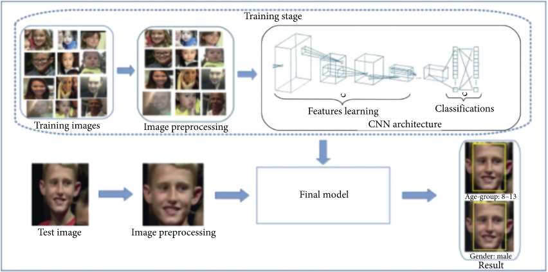
Proposed System Architecture Diagram

Slide 8
Convolutional Neural Network
Convolutional Neural Networks
A Convolutional neural network (CNN)is a type of artificial neural network that has one or more convolution layers and are used mainly for image processing, classification, segmentation and also for other auto correlated data. Deep learning is a machine learning based artificial neural network that recognize objects in image by progressively extracting features from data through higher layers.

Slide 9
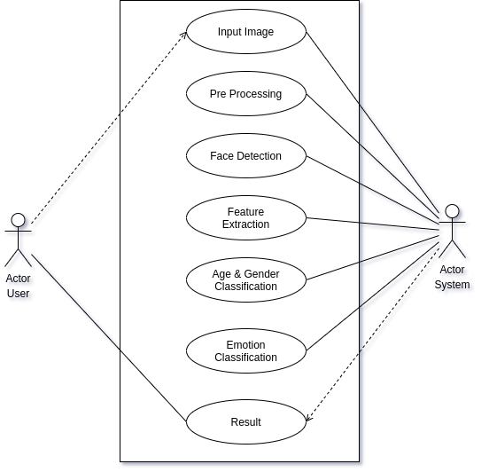
Design Of Project

Slide 10
Why Data Models?
1. Accuracy: Data models are used in face recognition systems to improve accuracy. These models are trained on large datasets containing images of faces from various angles, lighting conditions, and demographics. By analyzing these datasets, the models learn to identify patterns and features that are unique to individuals' faces. This enables them to make accurate predictions and distinguish between different faces, even in challenging conditions.
2. Efficiency: Data models help optimize the efficiency of face recognition systems. Once a model is trained, it can quickly process and analyze new face images, making it suitable for real-time applications. The models are designed to extract relevant facial features and compare them with a database of known faces, enabling rapid identification and verification.
3. Adaptability: Face recognition data models can be continuously improved and adapted to new scenarios. By retraining the model with additional data, it can become more robust and accurate over time. This adaptability allows the system to handle variations in facial appearances due to changes in hairstyle, facial hair, or aging. Additionally, data models can be updated to incorporate new techniques or algorithms, ensuring that the face recognition system stays up-to-date with the latest advancements in the field.

Slide 11
Tiny Face Detection Model
The Tiny Face Detector is a very performant, realtime face detector, which is much faster, smaller and less resource consuming compared to the SSD Mobilenet V1 face detector, in return it performs slightly less well on detecting small faces. This model is extremely mobile and web friendly, thus it should be your GO-TO face detector on mobile devices and resource limited clients. The size of the quantized model is only 190 KB (tiny_face_detector_model).
The face detector has been trained on a custom dataset of ~14K images labeled with bounding boxes. Furthermore the model has been trained to predict bounding boxes, which entirely cover facial feature points.

Slide 12
SSD Mobilenet V1
For face detection, this project implements a SSD (Single Shot Multibox Detector) based on MobileNetV1. The neural net will compute the locations of each face in an image and will return the bounding boxes together with it's probability for each face. This face detector is aiming towards obtaining high accuracy in detecting face bounding boxes instead of low inference time. The size of the quantized model is about 5.4 MB (ssd_mobilenetv1_model).
The face detection model has been trained on the WIDERFACE dataset

Slide 13
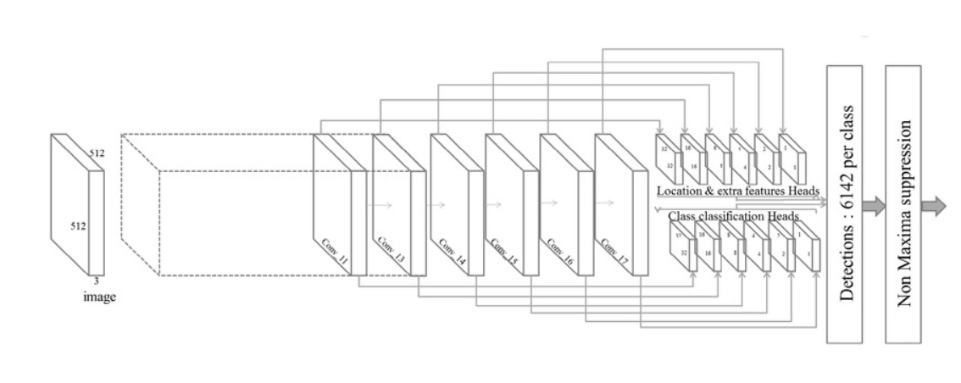
SSD Mobilenet V1

Slide 14
68 Point Face Landmark Detection
This model implements a very lightweight and fast, yet accurate 68 point face landmark detector. The default model has a size of only 350kb (face_landmark_68_model) and the tiny model is only 80kb (face_landmark_68_tiny_model).
Both models employ the ideas of depth wise separable convolutions as well as densely connected blocks. The models have been trained on a dataset of ~35k face images labeled with 68 face landmark points.

Slide 15
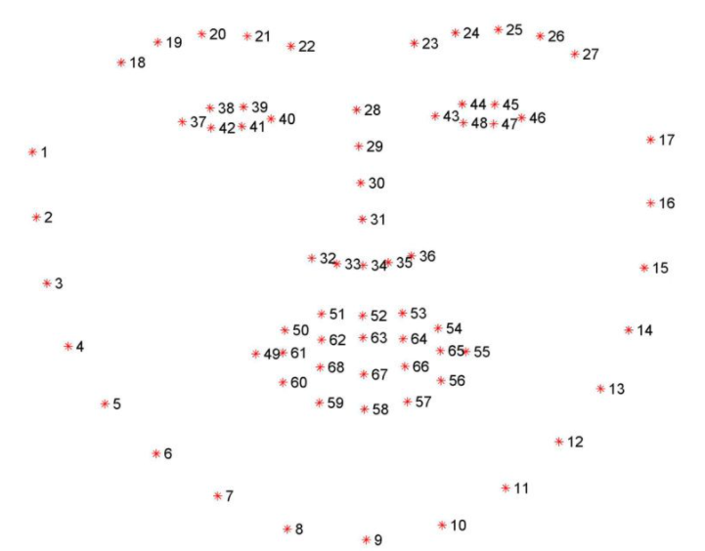
68 Landmarks

Slide 16
Face Expression Recognition Model
The face expression recognition model is lightweight, fast and provides reasonable accuracy. The model has a size of roughly 310 kb and it employs depth wise separable convolutions and densely connected blocks.
It has been trained on a variety of images from publicly available datasets as well as images scraped from the web.
Note, that wearing glasses might decrease the accuracy of the prediction results.

Slide 17
Age and Gender Recognition Model
The age and gender recognition model is a multitask network, which employs a feature extraction layer, an age regression layer and a gender classifier.
The model has a size of roughly 420kb and the feature extractor employs a tinier but very similar architecture to Xception.

Slide 18
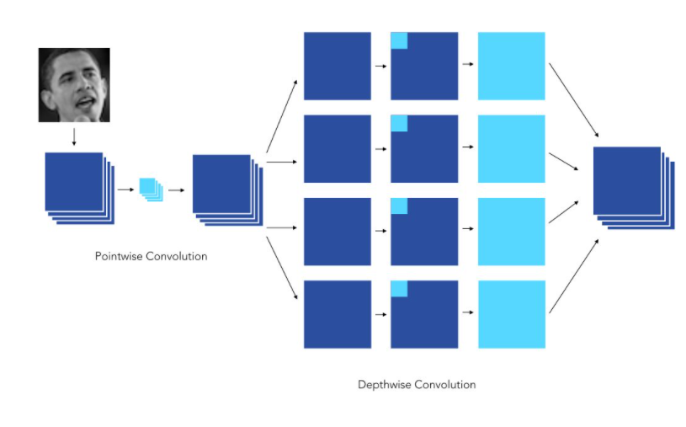
Age and Gender Recognition

Slide 19

Use Case Diagram

Slide 20
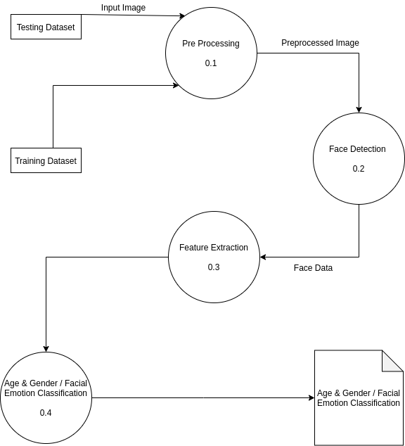
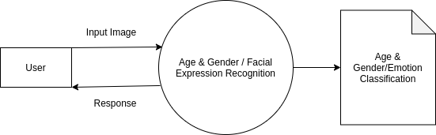
Work Flow

Slide 21
Future Work & Improvisations
In the future, the specified methodologies can be further improved by incorporating the below mentioned specifications in the implementation of the proposed mechanisms
Expression Recognition can be improved by adding feature for if human in wearing glasses attribute.
There is room for improvement in this project regarding the capability to recognize multiple faces simultaneously instead of just a single face image. Additionally, it involves analysing live video feed images.

Slide 22
Results
We were able to identify human age, gender and expression to a fair degree of accuracy, achieving 95.84% rate for age, 94.75% for gender and 91.23% for expression .
The trained model exhibited excellent performance, showcasing its potential in real-world applications such as security systems, emotion recognition technologies, and personalized marketing

Slide 23
Conclusion
An approach to detect the age, the gender and the expressions of the human in given image is proposed which uses tiny face detection, ssd mobilenet v1, 68 face landmark models and give better results than many model in this domain.
All with an API integration with a working script that runs independently on a Website.

Slide 24
--The End--
Thank You!

